Slide 1
Predicting Spine Assessment Clinic outcomes
Using textual MRI reports

Slide 2
Introduction
Objective
The SAC determines whether a patient experiencing chronic back or neck pain could benefit from spine surgery.
Typically, based on gathered information (MRI report, patient questionnaire), nurse/ surgeon assess whether the patient could benefit from spine surgery.
The decision is referred to as the SAC outcome.
To expedite the SAC decision making process.
To reduce surgical wait times of SAC.
Primary Objective: To use natural language processing techniques to develop a system that can predict the SAC outcome from textual MRI report.

Slide 3
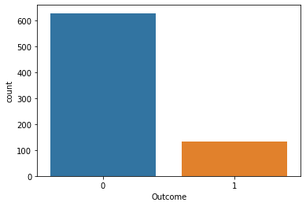
Dataset
Contains 763 textual MRI reports labelled with the SAC outcome for the patient.
Label of 1 indicates that surgery was recommended.
Label of 0 (negative) indicates that surgery was not recommended.
Out of 763 samples, 134 are labelled 1 and the rest 629 samples are labelled 0 (Class imbalanced).
The MRI reports typically contain: reason for exam, technique, findings, and impression.
Some reports deviate from usual format or use different section titles.

Slide 4
Methods
Data Preprocessing:
Converted all uppercase words to lowercase.
Removed words that occur in more than 90% of the training documents to get rid of frequent stop words.
Stop words convey very little semantic value (not convincing predictors).
Removed words that occur in less than 1% training texts (easy way to remove misspelled words and other irregularities).

Slide 5
Methods
Text Vectorization:
Bag-of-Words (BOW)
Keeps track of word counts in a text.
Disregards word order in a text.
Term frequency-inverse document frequency (TF-IDF)
Quantifies the relevance of a word to a text document based on its statistical significance.
Ignores word order in text as well.

Slide 6
Methods
Text Vectorization:
N-grams
Sequences of n words in a row.
BOW and TF-IDF vectorization can take some degree of context into consideration by using n-grams.
Experimentation was conducted for both BOW and TF-IDF with unigram and bigram.

Slide 7
Methods
Text Vectorization:
Word2Vec
Uses a neural network model to learn word associations from a large corpus of text.
Word vectors were generated using the word2vec implementation provided by the gensim library.
Length of the vector specified as 100.
Window count set to 5 to use the five preceding and succeeding words as context.
Generated vectors were averaged element wise to produce constant single 100 length for each report.

Slide 8
Methods
Models used:
Logistic Regression (with cost sensitive balanced weights).
SVM (with cost sensitive balanced weights).
An ensemble of LR + SVM (majority-rules voting classifier).
Complement Naive Bayes.

Slide 9
Methods
Handling Class Imbalance:
Two approaches were taken to correct the imbalance:
Augmenting the positive class.
Undersampling the negative class.
nlpaug library was utilized for data augmentation purposes.
nlpaug supports 3 types of augmentation:
Character-level
Word-level
Sentence-level
Conducted experiment with word-level synonym replacement to generate new positively labelled samples.
Can generate a textual MRI report without changing its overall meaning by simply replacing a few keywords with their synonyms.

Slide 10
Methods
Handling Class Imbalance:
Utilized nlpaug library to generate 250 samples from the positively labelled training texts for each fold.
Replacing 20% of the text with synonymous words.
Synonyms were retrieved using pre-trained word2vec embeddings. (trained on Google news dataset).
Under sampled negative class to create a class ratio of 1:2 for positive to negative samples.

Slide 11
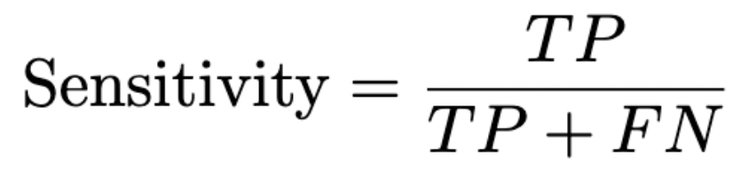
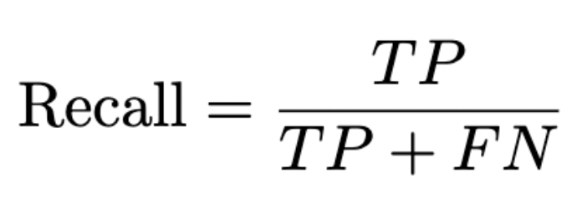
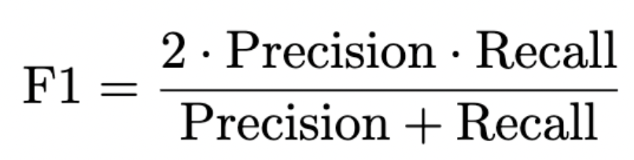
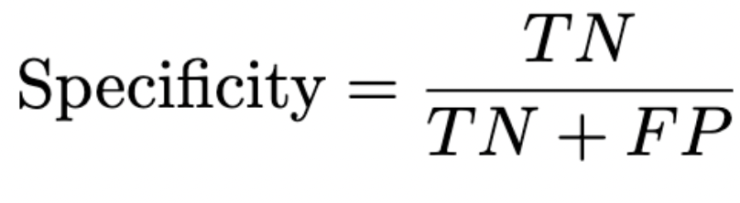
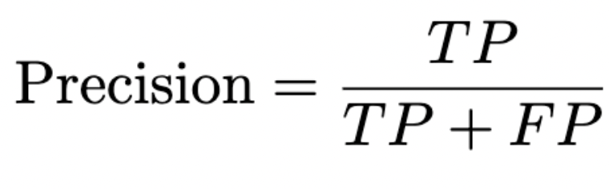
Methods
Evaluation Metrics:
Five-fold cross validation

Slide 12
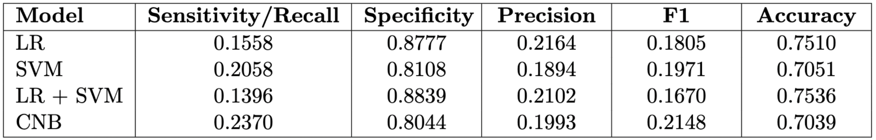
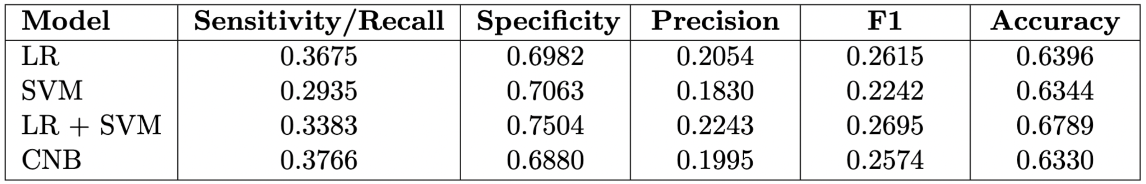
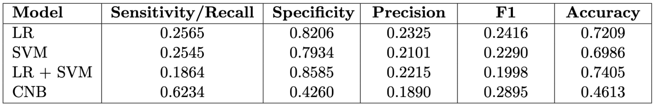
Results and Discussion
Bag-of-Words (BOW)
Original Data
Dropped Negative Samples
Augmented Data

Slide 13
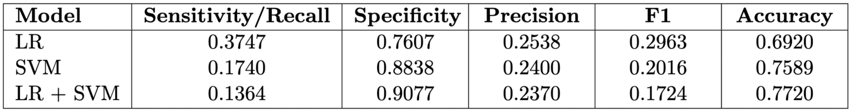
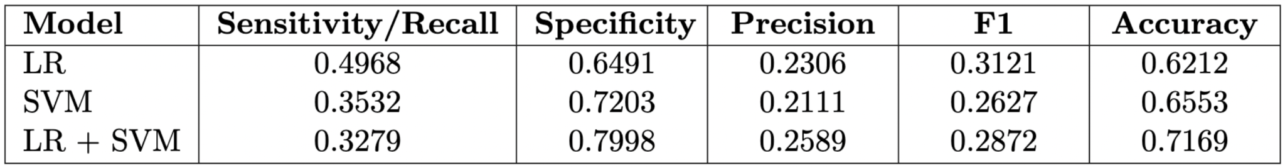
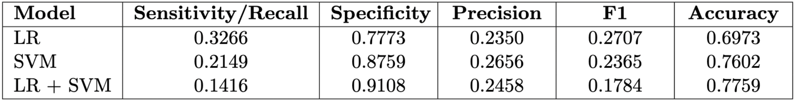
Results and Discussion
TF-IDF
Original Data
Dropped Negative Samples
Augmented Data

Slide 14
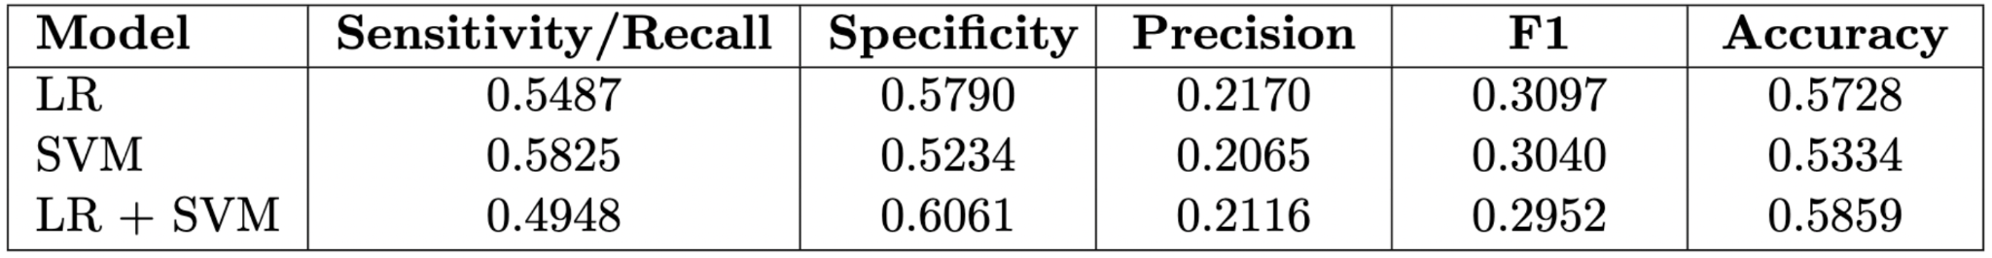

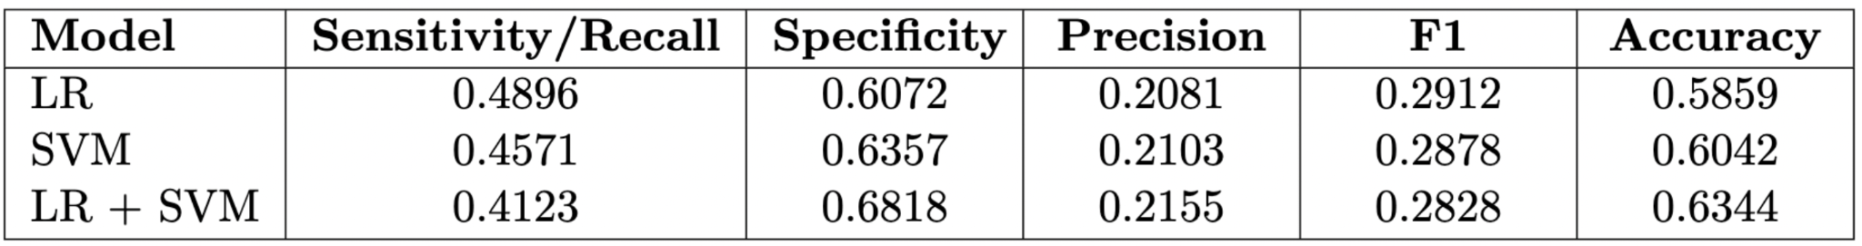
Results and Discussion
Word2Vec
Original Data
Dropped Negative Samples
Augmented Data

Slide 15
Conclusion & Future Work
Best-performing model
Word2Vec + Logistic Regression
Sensitivity: 0.55
Specificity: 0.58
Future Work
Further investigation into data augmentation techniques
More sophisticated approach to text preprocessing
Incorporate domain expert knowledge into the features
Make use of the patient questionnaires

